Slide 1

Vectorizers
Booz Allen Hamilton
A Cakes & Tensors Mentorship Project,
By Evan Mata, under Chao Wu
Dec 2020

Slide 2

agenda
Background
High Level NLP
My Data
BOW + TFIDF
Word2Vec
LSTMS
BERT
Comparisons
Questions

Slide 3



Natural Language Processing ( NLP )
Input Text
Output Text
API
Vectorizer
Parse Output
Input Numbers
Output Numbers
Algorithm

Slide 4
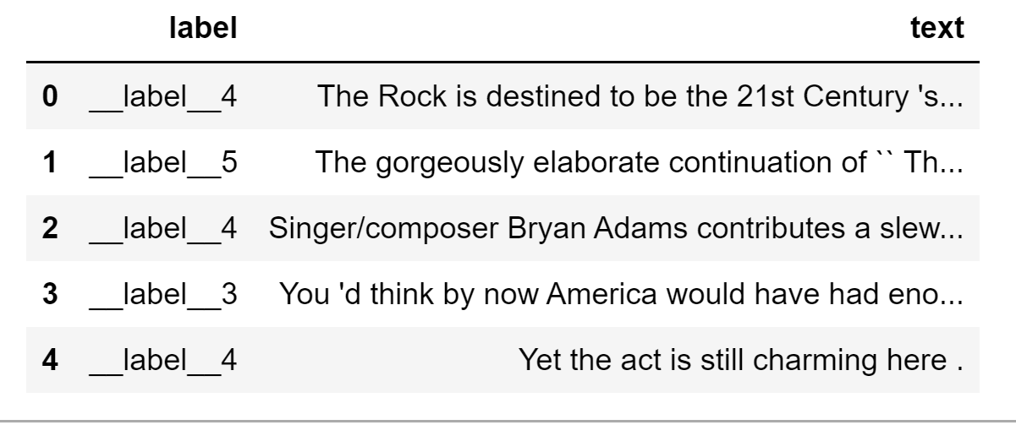
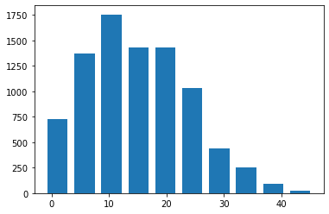
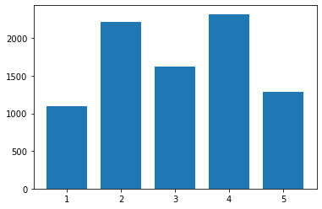
Dataset
Stanford Sentiment Treebank dataset
Sentiment Analysis:
5 labels (very negative to very positive)
~8k short (<50 words) movie reviews
Vast Majority 1 sentence
Word Count Distro
Labels Distro

Slide 5
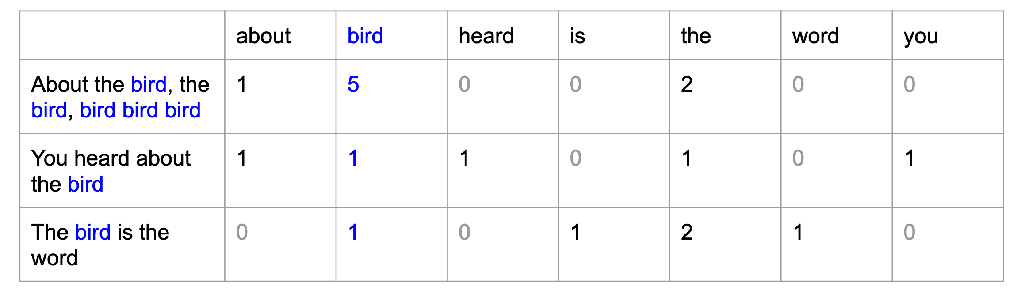
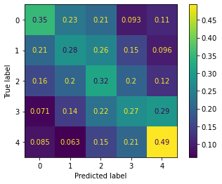
The Beginnings: Bag of Words ( BOW ) + Term Frequency – Inter-Document Frequency ( TFIDF )
BOW + TFIDF:
Pros:
Short, Simple, Easy to Understand
Captures information about the entire doc
Captures information about docs relative to each other
Cons:
Can be very sparse
No semantic or syntactic context
Doesn’t handle Out-Of-Vocab words well
Minimal sense of history
Homonyms
Results:
Alright – 37% Accuracy, off by one mostly.

Slide 6
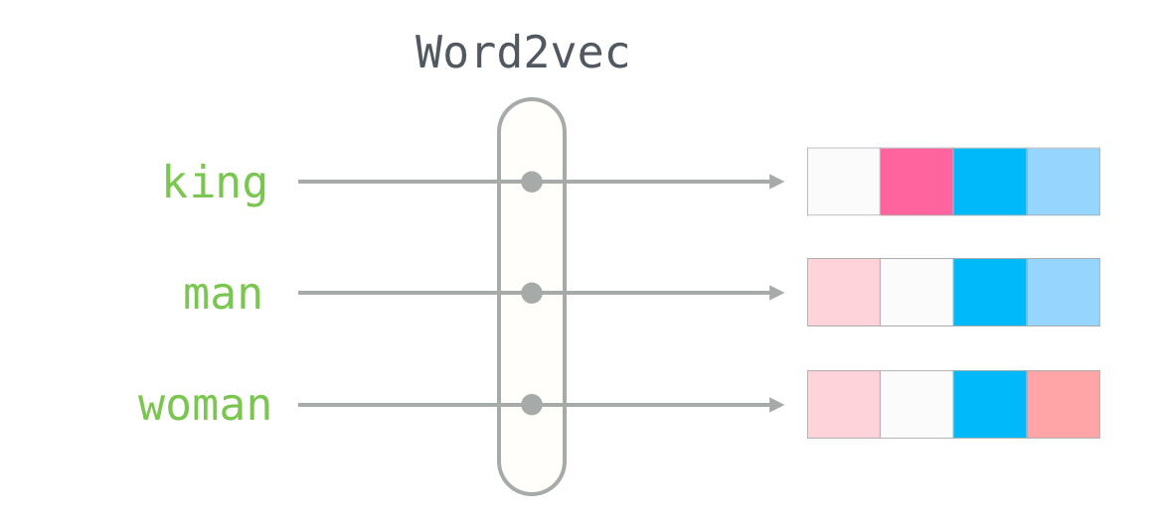
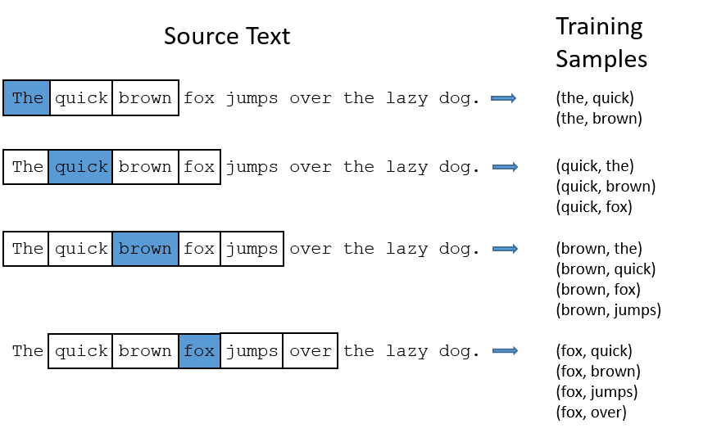
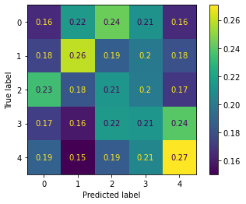
Embedding Models: Word2Vec (w2v)
W2V:
Pros:
Captures information about each individual word
Dense Vectors
Has semantic & syntactic context
Can use pre-trained Vectors
Cons:
Does not capture document level information well
Doesn’t handle Out-Of-Vocab words well
Minimal sense of history
Homonyms
Results:
Bad! 23-25%! Not consistent either!

Slide 7
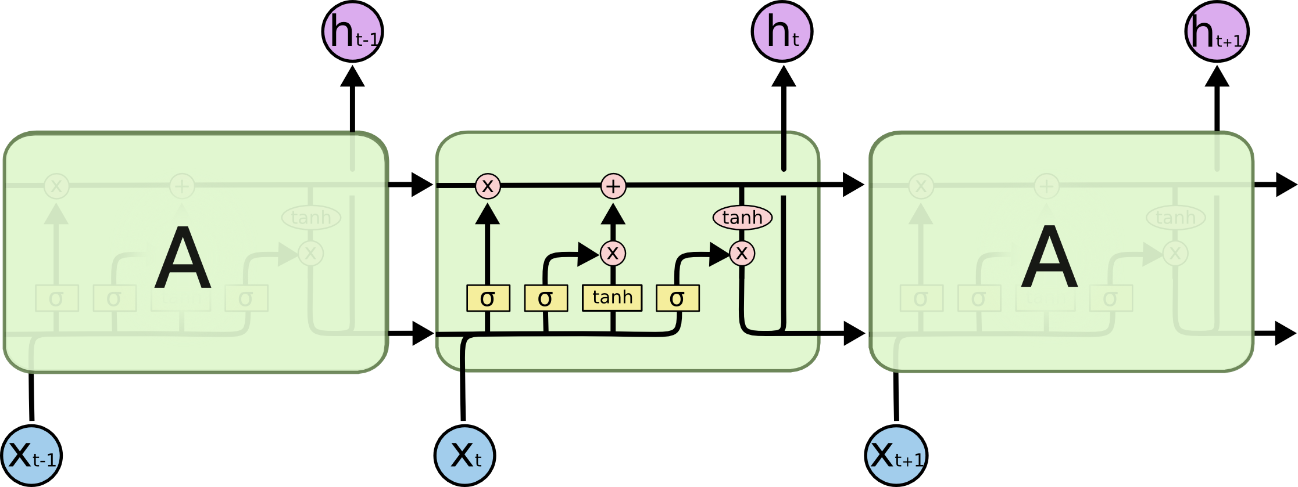
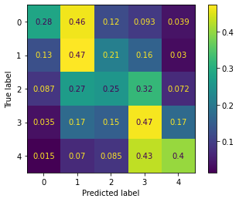
Recurrent Neural Nets (RNN): Long Short Term Memory (LSTM)
LSTM:
Pros:
Captures information about each individual word
Dense Vectors
Has semantic & syntactic context
Can use pre-trained Vectors
Captures good amount of history & context
Cons:
Does not capture document level information well
Doesn’t handle Out-Of-Vocab words well
Results:
Good, 40% accuracy, but strong mix up with Very-X and X

Slide 8
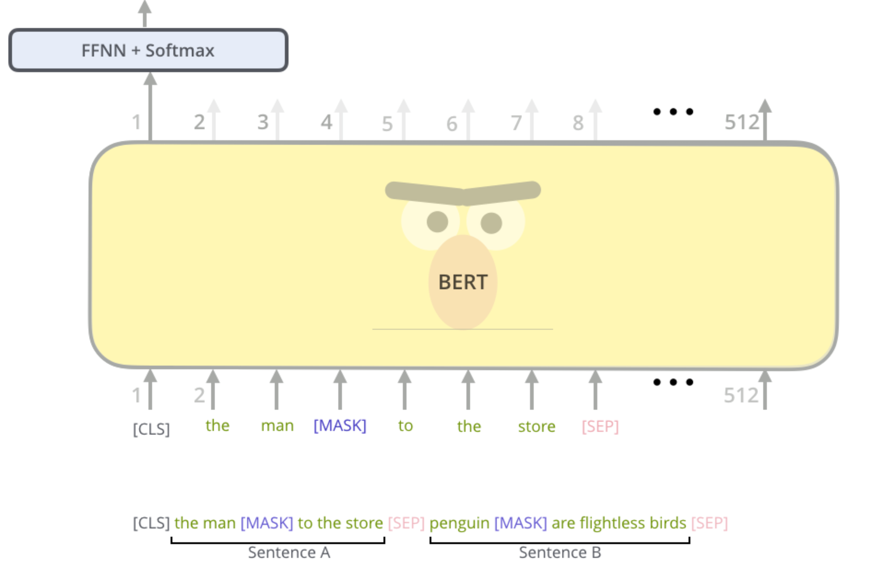
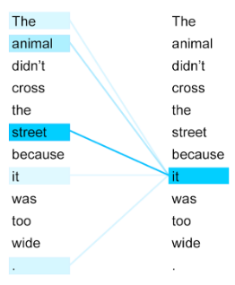
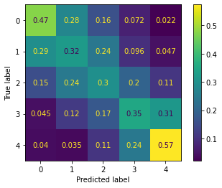
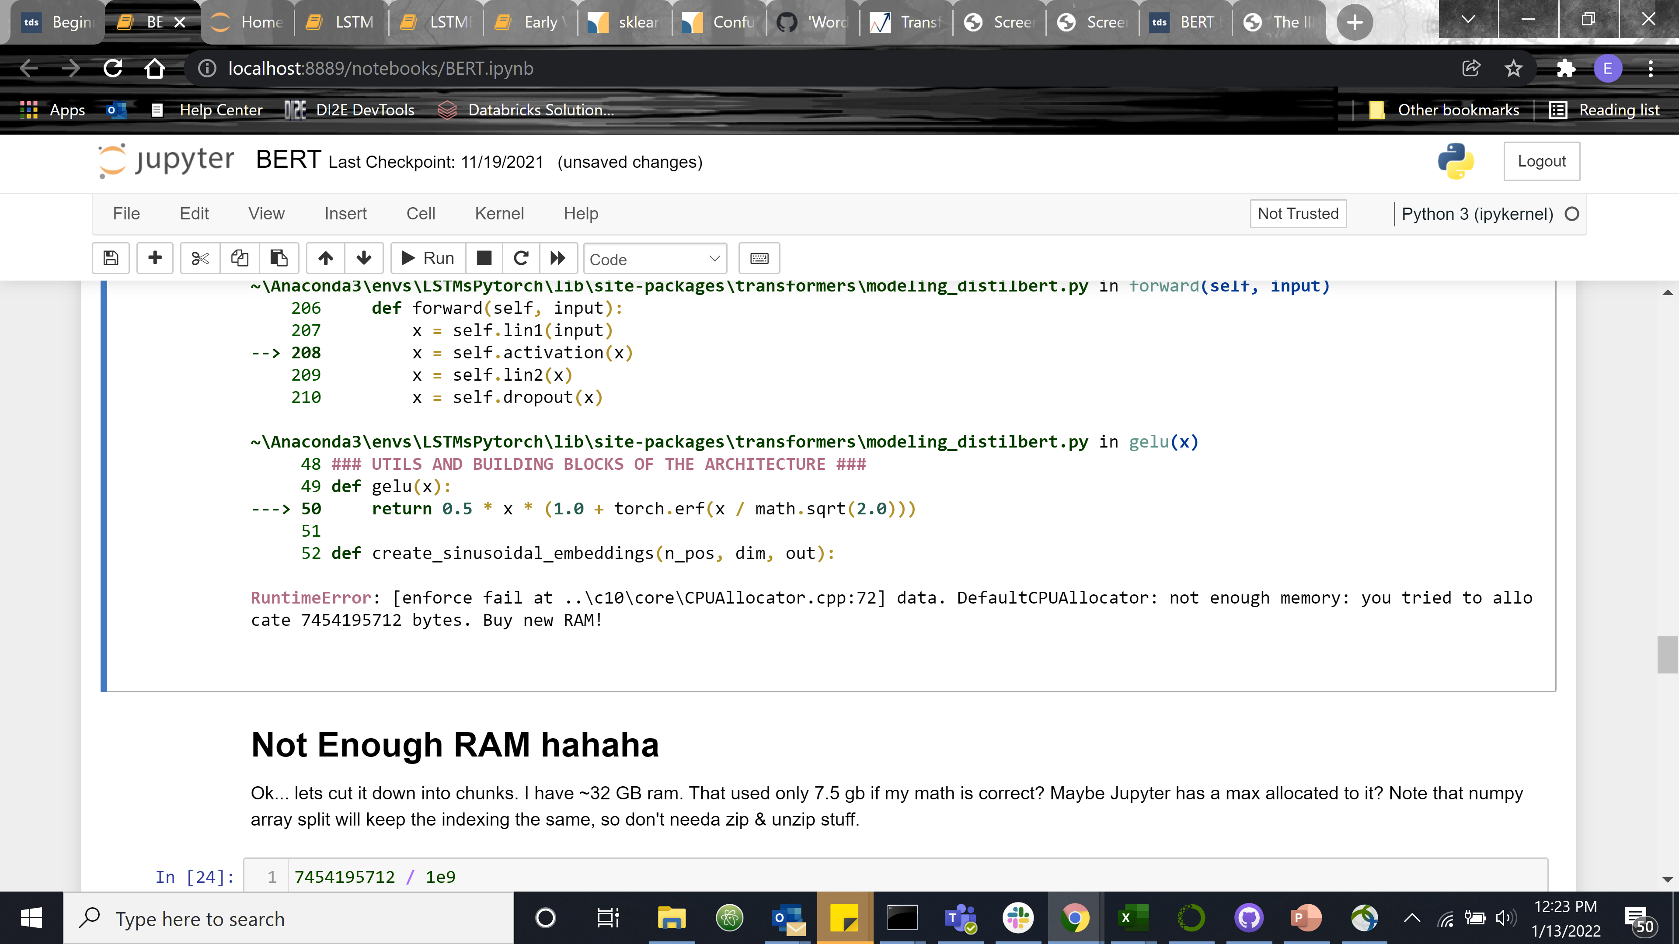
Bidirectional Encoder Representations from Transformers ( BERT )
BERT:
Pros:
Word & Doc level information
Dense Vectors
Has semantic & syntactic context
Can use pre-trained
Captures large amount of history & context
Cons:
Memory!
Complexity / explainability
Results:
Good! 39% Accuracy.

Slide 9
Comparisons
Model | BOW | BOW Bal | TFIDF | BOW SVD | W2V Vecs | W2V Mat | LSTM | BERT
Acc | 0.37 | 0.33 | 0.36 | 0.33 | 0.23 | 0.25 | 0.40 | 0.39
Observations:
Consistent:
Unbalance > balanced by ~2-5%
Off by 1 category
Focuses of models differ
Older Models Faster
Old Model Comparable given quantity of data

Slide 10
Questions?

Slide 11
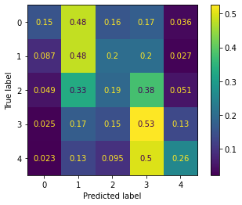
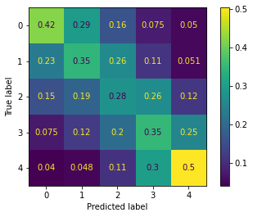
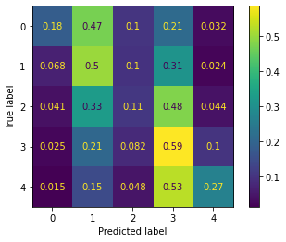
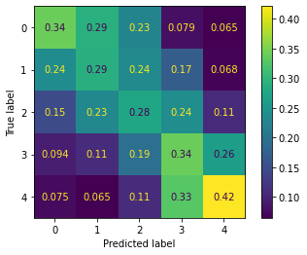
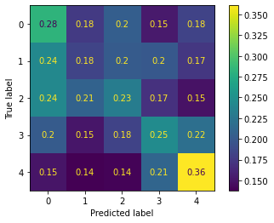
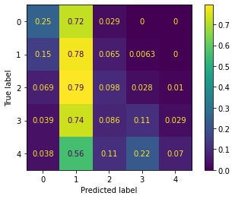
Some Confusion Matrices
LSTM Matrix Unbal
LSTM Vectors Bal
Unbalanced BOW
W2V Vectors
LSTM Balanced Mat
BERT Bal
W2V Matrices
LSTM Vectors Unbal
BERT Unbal
Balanced BOW

